Slide 1
Certification & Best Workplaces Lists Journey

Slide 2
Our mission is to help every place become a great place to work FOR ALL.

Slide 3
As a global authority in the workplace, Great Place To Work® supports organizations to achieve their best results through a culture of trust, high performance, and innovation.

Slide 4
Surveys conducted in 97 countries.
In 1997, the first list of the best companies in the world was published in Brazil.
12 million employees impacted every year.
Over 10,000 participating companies.

Slide 5
Many companies in Brazil are already doing this...

Slide 6
#GreatExperience
"It was an unprecedented experience, we are beginning the process of restructuring our Human Resources department, and this certification will assist us in maintaining continuity until we achieve excellence at all stages. It will also elevate us to a higher level in terms of credibility among other individuals and companies.“
Ana Leal from Guayaki Yerba Mate Brasil
"The survey methodology is well connected with current challenges, which aids in providing an excellent diagnosis of the organizational climate. Furthermore, the language of the questionnaire is very accessible, making it a distinctive advantage during its implementation and in the development of the work plan."
Cavalcante from NORSA REFRIGERANTES S.A
"We understand that Certification is extremely important and helps us to reflect on our practices.“
Siqueira from Fusopar Parafusos Ltda
"I highly recommend GPTW without any reservations; it's a survey with great credibility and consistency. I believe in the method, references, and practices that we achieve through conducting this research. Highly recommended!"
Sandra Oliveira from AMOR SAUDE LTDA

Slide 7
How does it work?

Slide 8
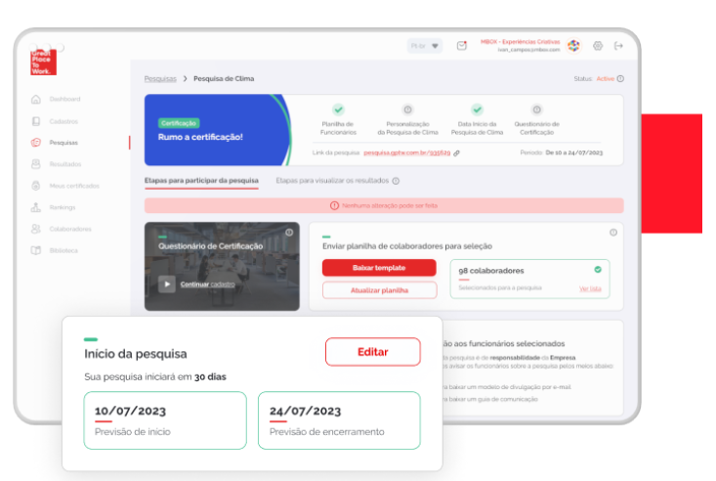
Apply the GPTW Survey
1
Select a date to begin the survey, and conclude it within 6 months of hiring. The survey will remain active for 15 consecutive days. After this period, the badge will be provided within 3 business days, depending on our audit process.

Slide 9
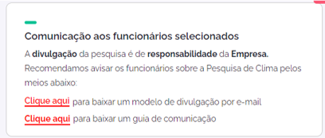
Inform your employees
2
Your company is responsible for communicating the employees about the access to the GPTW survey and the deadline for responding. We assist by providing communication materials, and you can track the progress of your survey through Connect.

Slide 10
Become certified
3
To achieve the certification, your organization will need to reach the minimum sample size of respondents and a score of at least 70 points on the GPTW Trust Index survey. Besides that, it is essential to meet our audit criteria. After the survey concludes, we will conduct a brief analysis within up to 3 business days to release the certification badge.
MINIMUM SAMPLE SIZE OF RESPONDENTS
70
+
=
Valid for 12 months
Survey period: 15 consecutive days.
Seal release: within up to 3 business days.

Slide 11
Compete in eligible Rankings
4
All certified companies are eligible to participate in the Best Workplaces Lists, at no additional cost.
Sectoral or Thematic
National
Regional
Ranking Participation Criteria

Slide 12
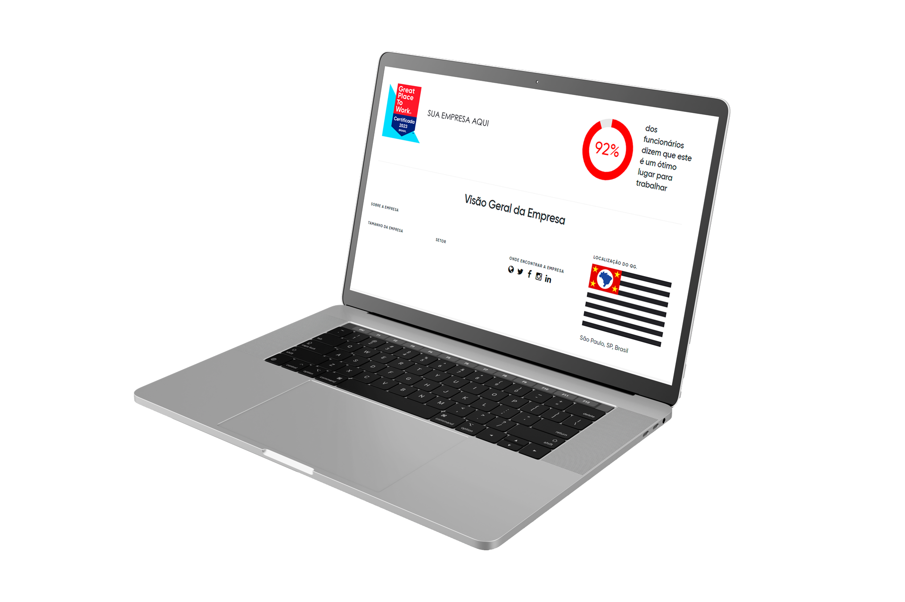
Certified companies receive an exclusive page on the GPTW website to expose even more your employer brand and also receive an access to the GPTW Store.

Slide 13
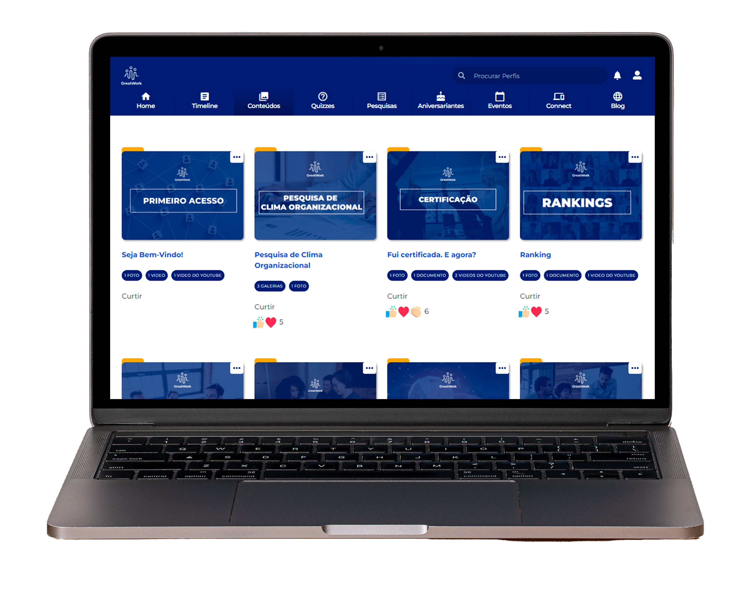
You become a member of the
GreatWork Community and gain access to exclusive content!

Slide 14
Certified Day
A day full of stories and connections among the employees
of companies that have achieved Certification!

Slide 15
What if my company is not certified?

Slide 16
Non-certified companies can apply a new survey after 3 months at no additional cost, provided they are up to date with their monthly payments.
Valid only for the 1st year of hiring
The new attempt can be made within 6 months from the date of the first survey.

Slide 17
Plans

Slide 18
Basic Plan Model | Pro Plan Model | Performance Plan Model
Survey Results
GPTW Report Includes analysis of survey results by question, highlighting strengths and areas for improvement.
E-NPS
Gauge if your employees feel sufficiently engaged to recommend your company.
IVR
Innovation Velocity Ratio (IVR) This metric assesses your company's innovation pace.
Leadership Phases Indicator
This indicator aims to identify the different leadership profiles within your company.
Comments Report
Access your employees' feedback in full.
Overall Average by Group
Access satisfaction indices segmented by categories such as job positions, departments, gender, age, state, among others.
Complete Results Tabulation
An example template of the results is available for review.
Understanding and Interpreting the Results One online presentation is provided for the interpretation of the results.

Slide 19
GPTW Survey and Benefits
Basic
Pro
Performance
Great Place to Work Survey
The ultimate benchmarking tool in management research to measure the quality of the internal environment and organizational culture, as well as to capture employee perceptions of the organization and leadership.
Survey Customization
Select up to 3 additional questions from a GPTW-suggested list. Customize roles and departments, which we refer to as demographics, with up to 11 available options and 1 additional grouping of your choice!
3 statements questions 2 customizable demographics 1 grouping
Benchmarking
Compare your company's survey results with the rankings of the Best Companies to Work For.
1 benchmark (comparison with the Brazil Ranking)
1 benchmark (comparison with the Brazil Ranking)
2 benchmarks
(comparison with the Brazil Ranking + 1 Ranking of choice)
Cultural Practice Recommendations
Using our survey's algorithm, we'll map scores to improvement opportunities and suggest cultural practices to address these areas within your company.
2 Practices
3 Practices
4 Practices
Access to the Great Work Community
Become a member of the Great Work Community and gain access to exclusive content!
Exclusive Page for Certified Companies
Once certified, your company will have an exclusive page on the GPTW website and access to the GPTW's exclusive store with customizable items!

Slide 20
MONTHLY PAYMENT (12x)
OR
UPFRONT PAYMENT
Range of employees in your company
Minimum contract of 12 months *Recurring billing, does not affect the credit card limit
Basic
Pro
Performance
Between 30 and 99 employees | R$ 543,29 Ou R$ 6.519,48 | R$ 845,79 Ou R$ 10.149,48
Between 100 and 499 employees | R$ 797,39 Ou R$ 9.568,68 | R$ 1.063,59 ou R$ 12.763,08
Between 500 and 999 employees | R$ 1.148,29 Ou R$ 13.779,48 | R$ 1.801,69 Ou R$ 21.620,28
Between 1.000 and 4.999 employees | R$ 1.499,19 Ou R$ 17.990,28 | R$ 2.237,29 Ou R$ 26.847,48
For more than 5.000 employees | R$ 3.780,15 Ou R$ 45.361,80 | R$ 4.093,65 Ou R$ 49.123,80
R$ 1.390,29 Ou R$ 16.683,48
R$ 1.922,69 Ou R$ 23.072,28
R$ 2.527,69 Ou R$ 30.332,28
R$ 3.616,69 Ou R$ 43.400,28
R$ 5.016,28 Ou R$ 60.195,30

Slide 21
Standalone Service
GPTW INVITES
An invitation extended by GPTW to employees, clarifying and emphasizing the purpose of the survey, our role, and the employee's role in this process.
Exclusively online presentation Duration: 30 minutes Platform: Zoom, Teams, Google, or another link of the company's preference. The presentation is not customizable
R$ 2.329
Upfront payment

Slide 22
Important:

Slide 23
Customer Support and Assistance
Provided by our customer service team.
Who will support me after hiring?
Who will assist me after the survey has been conducted?
We're here!
Consultant
Onboarding Channel
Customer Service Team
New Business / Hiring
Videos, materials, and weekly Q&A sessions.
Support / Access / Financial Solutions, etc.

Slide 24
Survey Rules
Not Allowed: a) Influence or in any way hinder the freedom of employees in their survey responses;
b) Gather or accompany employees for the completion of the form;
c) Offer any kind of prizes to employees in an attempt to obtain the GPTW certification;
d) Link the Profit Sharing (PLR) of non-leader employees to the company's evaluation in the survey;
e) Insinuate or indicate the possibility of punishments for employees if the company does not obtain the certification or ranking position;
f) Give gifts to employees who respond to the survey;
g) Pressure employees to respond to the survey (like informal messages asking if the survey has been answered);
h) Ask for any type of proof of survey response from employees;
i) Specify or influence the type of response that is considered for the survey average.

Slide 25
Additional Information
The GPTW Survey must be conducted within 6 months from the date of hiring the Certification Journey and must be completed by the last day of this period.
Upon meeting the necessary criteria, the GPTW Certification seal is valid for 12 months, and for its use, the company must be current with the monthly fees of the Certification Journey.
For contract cancellation, a 30-day prior notice is required, and there will be a penalty charge corresponding to 40% of the remaining value until the end of the contract.
Cancellation also results in the deactivation of the seal and access to GPTW Connect.
The contract will be automatically renewed after 1 year.

Slide 26
Better for people, business, and society.
Contact
Maraisa Meira Ohse
E: maraisa.ohse@greatplacetowork.com
T: +55 (54) 99602-5543
www.gptw.com.br

